Slide 1
Controlling Molecular Orbital Gating In Molecular Junctions
Francis Adoah

Slide 2
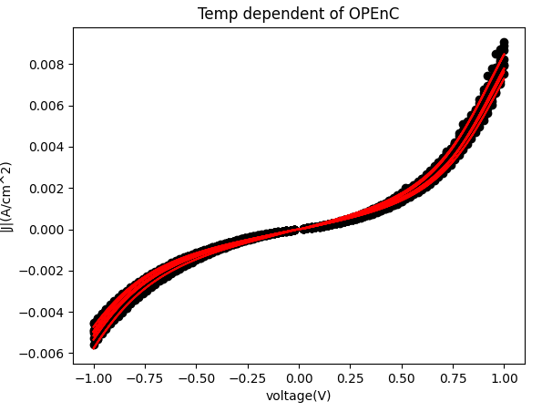
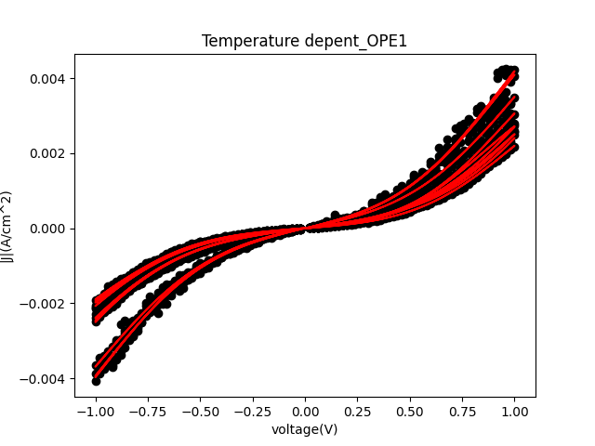
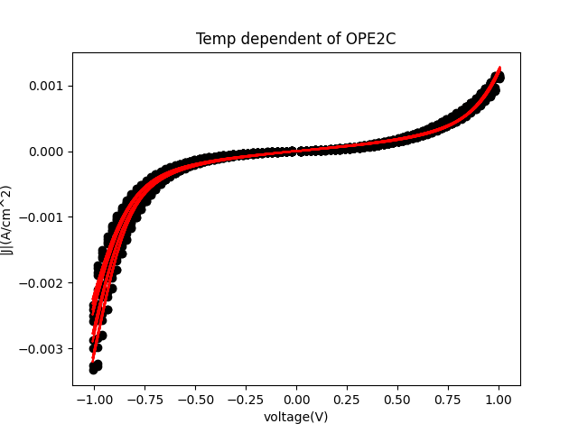
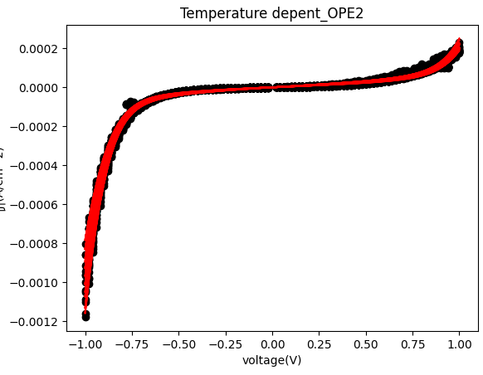
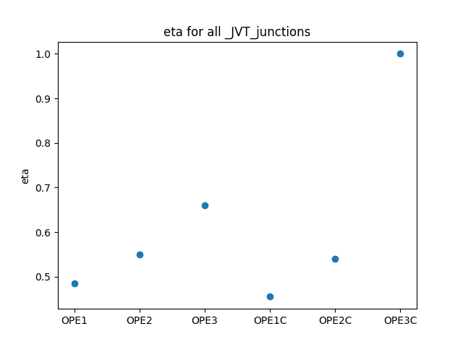
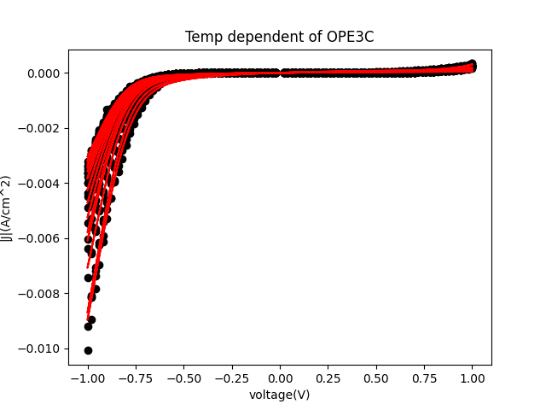
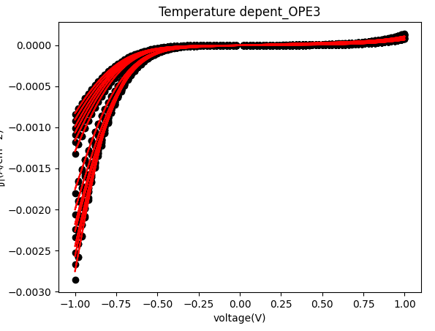
JVT Calculation
Landauer was used to fit all of the JV curves for each molecule. The curves were fit such that the parameters for each molecule were held constant with only the temperature being allowed to vary.
As is clearly seen, as n increases the asymmetry of the molecule also increases which is represented by the eta parameter. Given below. This asymmetric behavior could have an effect on the charging of the molecule which could explain the position of the inverted Marcus region.

Slide 3
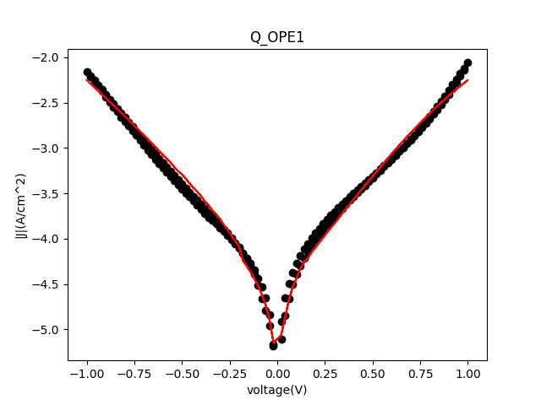
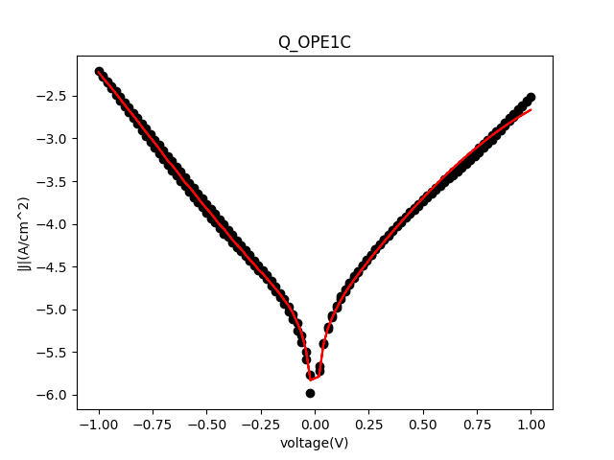
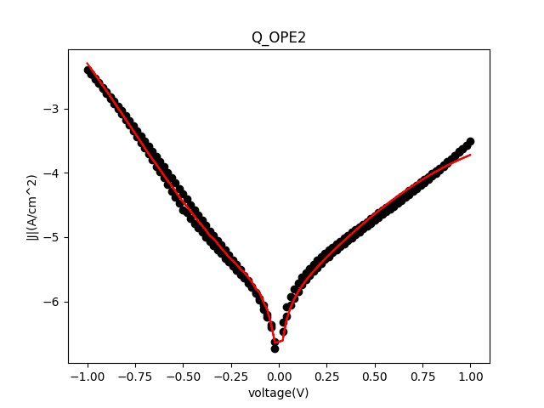
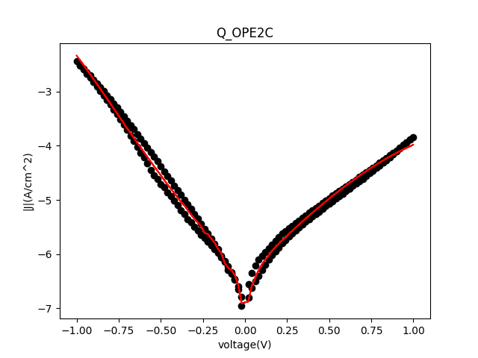
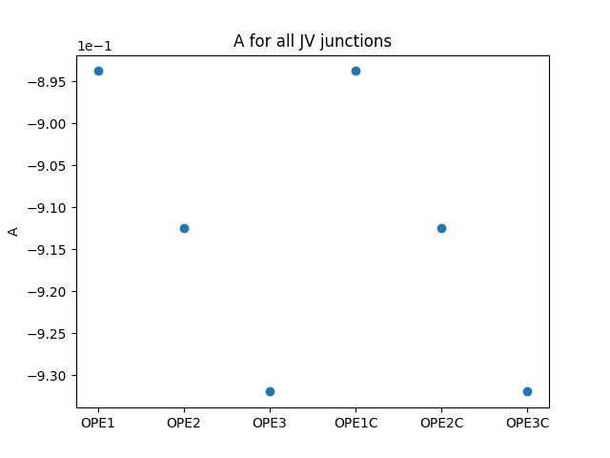
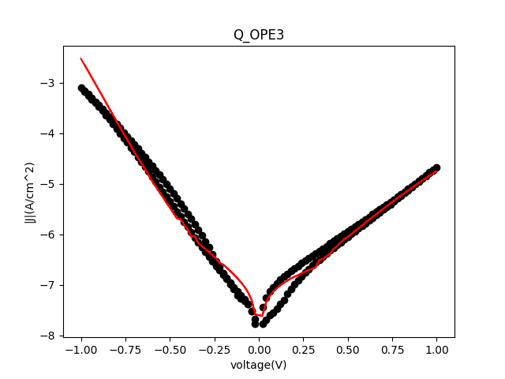
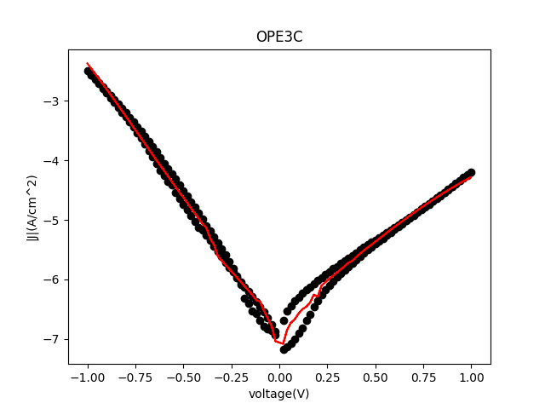
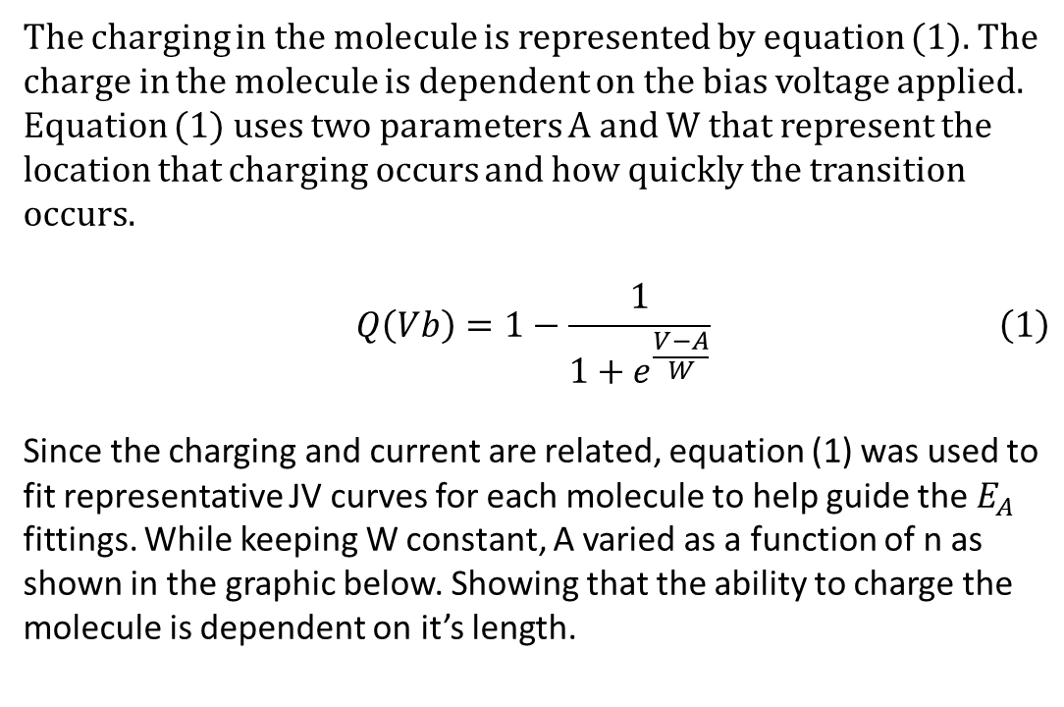
The following were done by assuming Q(Vb)=I(Vb)
The charging in the molecule is represented by equation (1). The charge in the molecule is dependent on the bias voltage applied. Equation (1) uses two parameters A and W that represent the location that charging occurs and how quickly the transition occurs.
$$\begin{aligned}Q\left(Vb\right)=1−\frac{1}{1+e^{\frac{V−A}{W}}}\#\left(1\right)\end{aligned}$$
Since the charging and current are related, equation (1) was used to fit representative JV curves for each molecule to help guide the $E_{A}$ fittings. While keeping W constant, A varied as a function of n as shown in the graphic below. Showing that the ability to charge the molecule is dependent on it’s length.

Slide 4
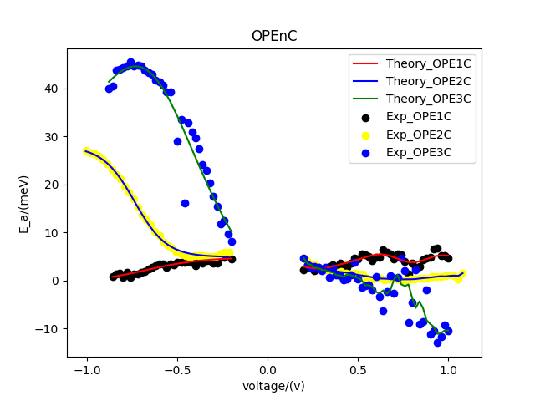
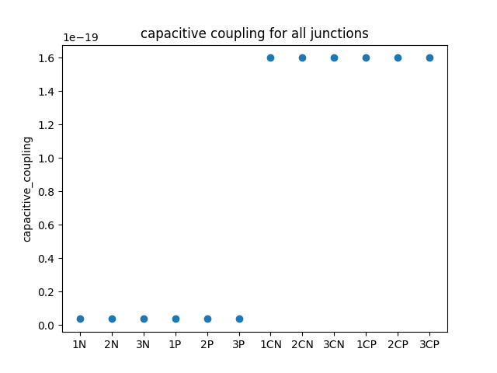
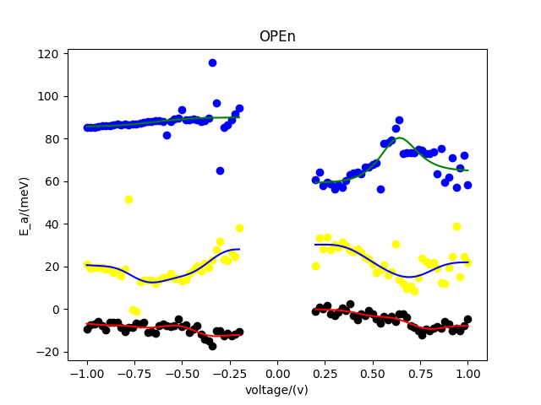
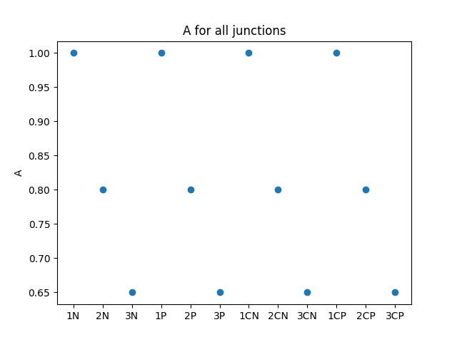
Activation Energy Calculation
The plots to the left show that the OPEnC species have a higher capacitive coupling than the OPEn species and that this allows for inverted Marcus regime to appear.
While changing the length of the molecule changes the how it charges thereby moving the peak in the activation energy.

